Slide 1
ENTREPRENEURSHIP
Lecture No: 16
Resource Person:
Malik Jawad Saboor
Assistant Professor
Department of Management Sciences
COMSATS Institute of Information Technology
Islamabad.

Slide 2
TOWS MATRIX

Slide 3
TOWS Matrix
SO Strategies
Strategies that enable competitive advantage, external opportunities match well with internal strengths, allows for competitive advantage to be built and maintained.

Slide 4
TOWS Matrix
ST Strategies
Mitigation Strategies, firm possesses internal strengths that facilitates neutralization of external threats, may lead to temporary advantage if competitors are impacted by environmental threats.

Slide 5
TOWS Matrix
WO Strategies
Acquisition/Development Strategies, situation where strategies are formulated to acquire or develop new resources/capabilities to take advantage of external opportunities.

Slide 6
TOWS Matrix
WT Strategies
Consolidation/Exit Strategies, if firms can’t find ways to convert weaknesses to strengths via acquisition/development, exit from market is recommended.

Slide 7
TOWS Matrix

Slide 8
Feasibility Analysis
Entrepreneurs do not lack creative ideas, but…
Is a particular idea a viable foundation for creating a successful business?
Feasibility study addresses the question: “Should we proceed with this business idea?”

Slide 9

Feasibility Study
Not the same as a business plan.
Serves as a filter, screening out ideas that lack the potential for building a successful business before an entrepreneur commits the necessary resources to building a business plan.
An investigative tool.

Slide 10
Elements of a Feasibility Analysis
Industry and
Market Feasibility
Product or Service
Feasibility
Financial
Feasibility

Slide 11
Elements of a Feasibility Analysis
Industry and
Market Feasibility
Product or Service
Feasibility
Financial
Feasibility

Slide 12
Industry and Market Feasibility Analysis
Two areas of focus:
Determining how attractive an industry is overall as a “home” for a new business.
Identifying possible niches a small business can occupy profitably.

Slide 13
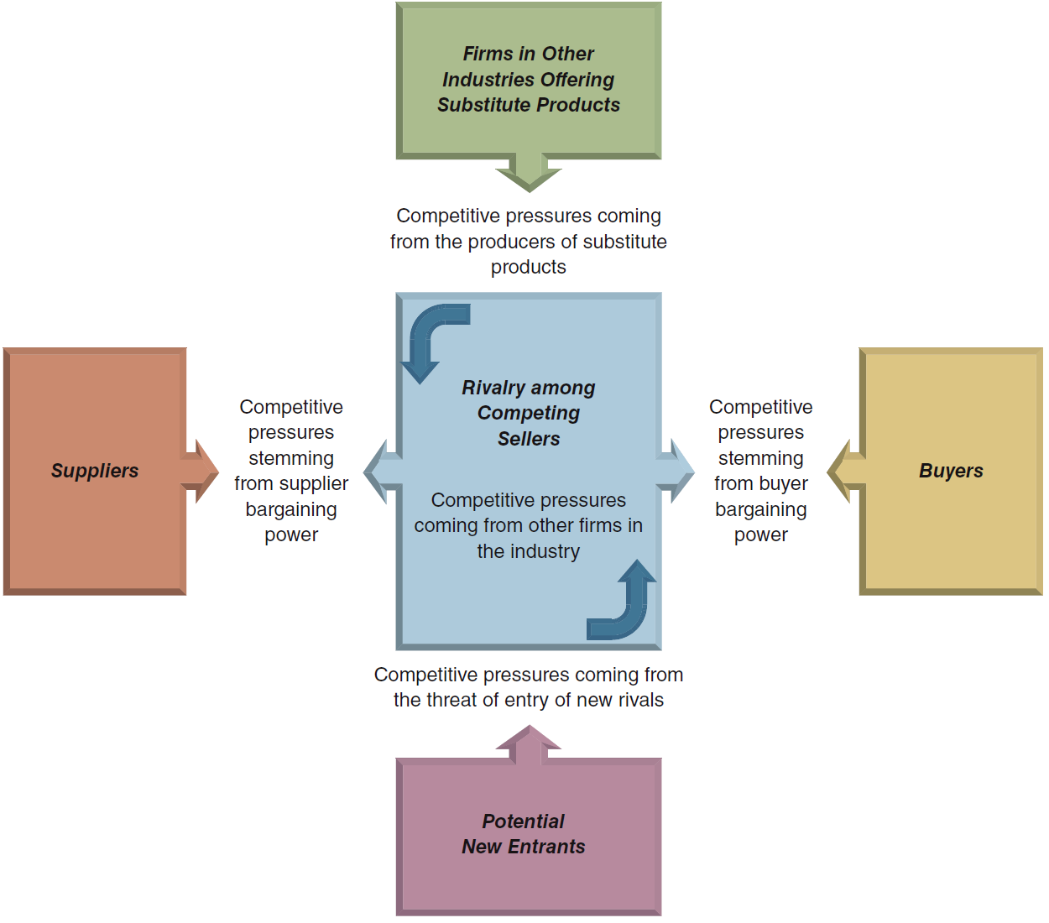
The Five-Forces Model of Competition: A Key Analytical Tool

Slide 14
Factors Affecting the Strength of Rivalry
Slow growth in product demand
Low switching cost
Competitors are numerous and of almost same size
Factors Affecting the Threat of Entry
Entry ease/barriers
Buyers demand is increasing rapidly
Large pool of potential entrants
Factors Affecting Supplier Power
Supplies are in limited supply
No substitute available
High Switching Costs

Slide 15
Factors Affecting Competition from Substitute Products
Good substitutes are readily available
Substitutes have better performance features
Buyers have low cost of Switching
Factors Affecting the Bargaining Power of Buyers
Industry Products are standardized
Low Switching cost
Buyers are well informed about to quality and prices
Low number of buyers

Slide 16

Business Prototyping
Entrepreneurs test their business models on a small scale before committing serious resources to launch a business that might not work.
Recognizes that a business idea is a hypothesis that needs to be tested before taking it full scale.

Slide 17
Elements of a Feasibility Analysis
Industry and
Market Feasibility
Product or Service
Feasibility
Financial
Feasibility

Slide 18

Product or Service Feasibility Analysis
Determines the degree to which a product or service idea appeals to potential customers and identifies the resources necessary to produce it.
Two questions:
Are customers willing to purchase our good or service?
Can we provide the product or service to customers at a profit?

Slide 19
Product or Service Feasibility Analysis
Primary research – collect data firsthand and analyze it.
Customer surveys and questionnaires
Focus groups
Secondary research – gather data that already has been compiled and analyze it.
Prototypes
In-home trials

Slide 20
Elements of a Feasibility Analysis
Industry and
Market Feasibility
Product or Service
Feasibility
Financial
Feasibility

Slide 21

Financial Feasibility Analysis
Capital requirements – must have an estimate of how much start-up capital is required to launch the business.
Estimated earnings – forecasted income statements.
Return on investment – combining the previous two estimates to determine how much investors can expect their investments to return.

